Slide 1
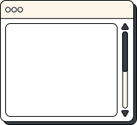


MATHS
Optimization in Deep Learning: Concepts & Convexity

Slide 2


TEAM MEMBER
Nguyễn Minh Tuấn - 2470574
Nguyễn Trần Phước - 2470576
Lê Trí Quyền - 2470740
Lê Quang Trung - 2470746
Trần Hoàng Nguyên - 2470739
THINK
PAIR
SHARE

Slide 3


TABLE CONTENT
Optimization & Deep learning
Optimization issues
Convexity: Convex Sets & Convex Functions
Key property & Constraint

Slide 4

OPTIMIZATION
Minimize the loss function
Reduce the training error

Slide 5
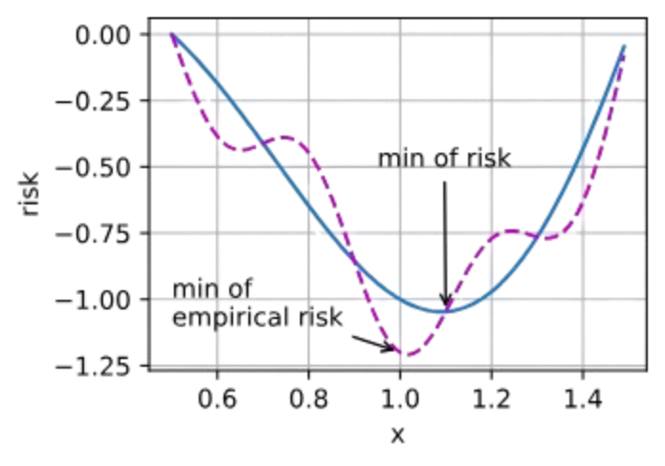
DEEP LEARNING
Finding a suitable model, given a finite amount of data
Reduce the generalization error

Slide 6

OPTIMIZATION ISSUES
LOCAL MINIMA
For any objective function f(x), if the value of f(x) at x is smaller than the values of f(x) at any other points in the vicinity of x, then f(x) could be a local minimum.
If the value of f(x) at x is the minimum of the objective function over the entire domain, then f(x) is the global minimum.

Slide 7
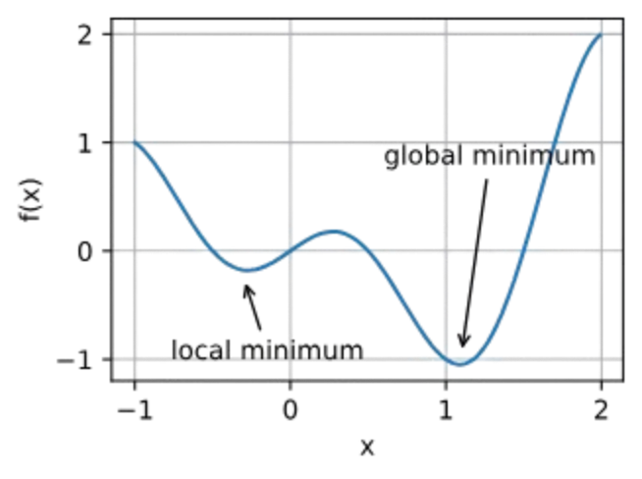
OPTIMIZATION ISSUES
LOCAL MINIMA
The optimization problems may have many local minima.

Slide 8
OPTIMIZATION ISSUES
SADDLE POINTS
A saddle point is any location where all gradients of a function vanish but which is neither a global nor a local minimum.
Consider the function f(x)=x^3. Its first and second derivative vanish for x=0. Optimization might stall at this point, even though it is not a minimum.

Slide 9
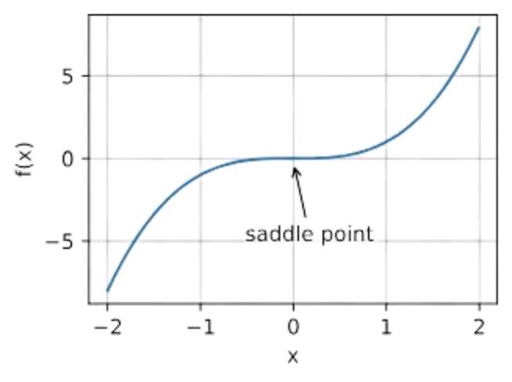
OPTIMIZATION ISSUES
SADDLE POINTS
The problem may have even more saddle points, as generally the problems are not convex.

Slide 10
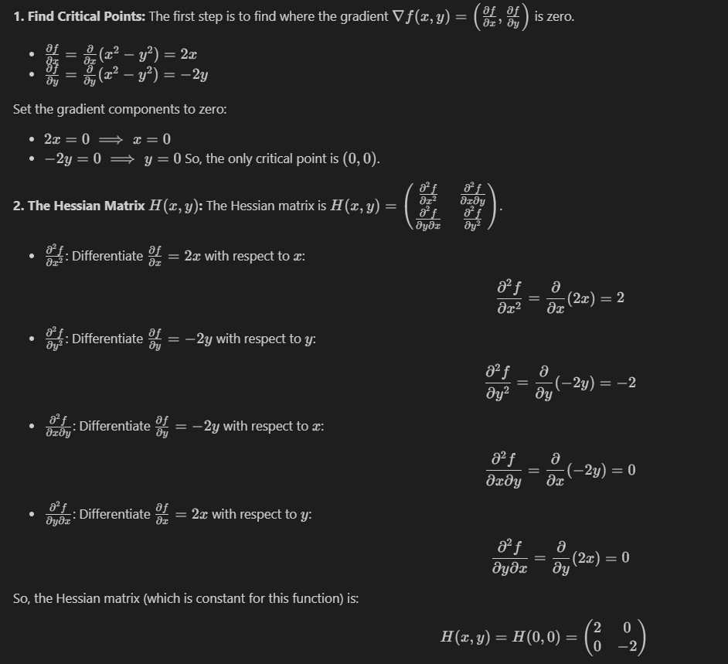
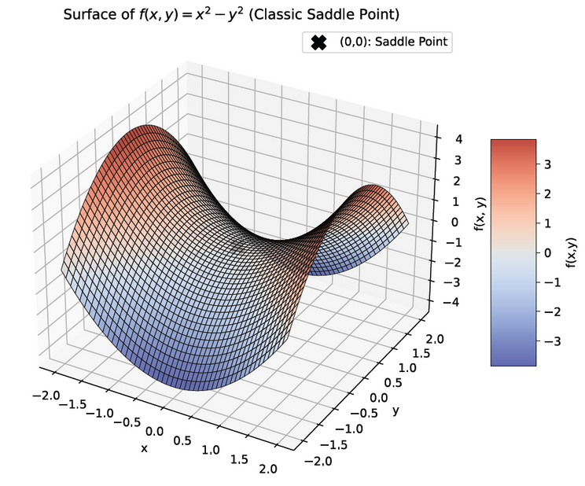
OPTIMIZATION ISSUES
SADDLE POINTS
Example: f(x,y) = x2 - y2

Slide 11
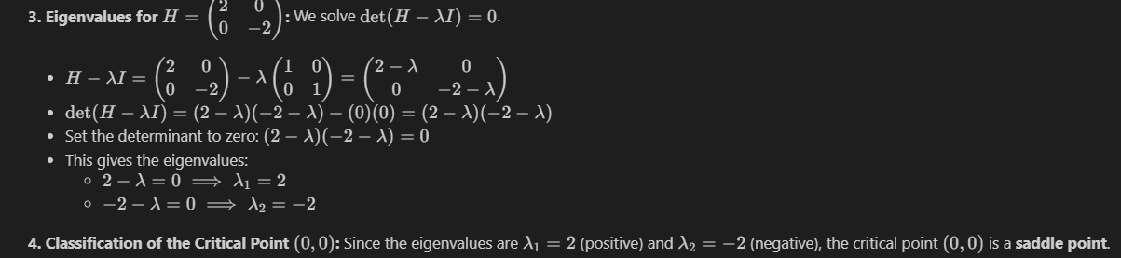
OPTIMIZATION ISSUES
SADDLE POINTS
Example: f(x) = x2 - y2

Slide 12
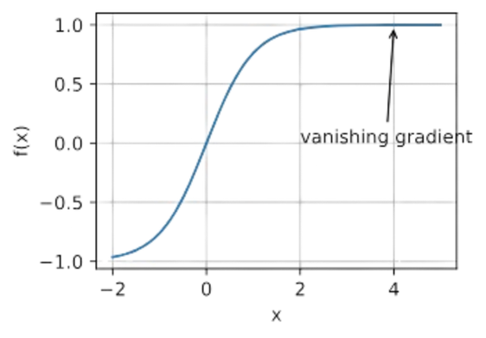
OPTIMIZATION ISSUES
VANISHING GRADIENTS
In a neural network, learning happens by adjusting the network's weights based on the error (or loss) calculated at the output. The backpropagation algorithm computes the gradient (which is essentially the derivative of the loss function with respect to each weight) and uses this gradient to update the weights. The vanishing gradient problem occurs when these gradients become extremely small as they are propagated backward from the output layers to the earlier layers of the network
For instance, assume that we want to minimize the function f(x)=tanh⁡(x) and we happen to get started at x=4. The gradient of f is close to nil. More specifically, f′(x)=1−tanh^2⁡(x) and thus f′(4)=0.0013.
Vanishing gradients can cause optimization to stall.

Slide 13
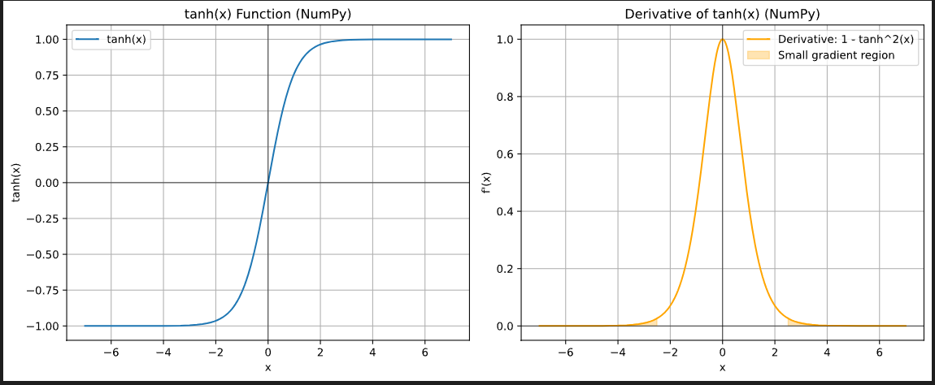
OPTIMIZATION ISSUES
VANISHING GRADIENTS

Slide 14
OPTIMIZATION ISSUES
VANISHING GRADIENTS
Slow Training: The most immediate effect is that the network trains very slowly, as the earlier layers are not updated effectively.
Poor Performance: If the early layers don't learn, the network cannot learn complex features and will likely perform poorly on the task it's being trained for.
Inability to Train Deep Networks: Vanishing gradients historically made it very difficult to train very deep neural networks effectively.

Slide 15
CONVEXITY
Convexity plays a vital role in the design of optimization algorithms.
This is largely due to the fact that it is much easier to analyze and test algorithms in such a context.

Slide 16

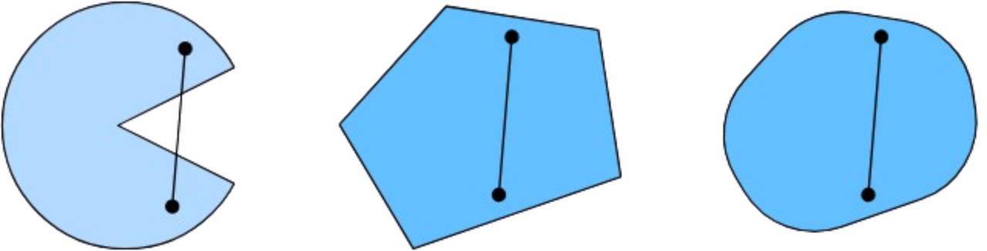
CONVEX SETS
Sets are the basis of convexity. Simply put, a set X in a vector space is convex if for any a,b∈X the line segment connecting a and b is also in X.
The first set is nonconvex and the other two are convex.

Slide 17
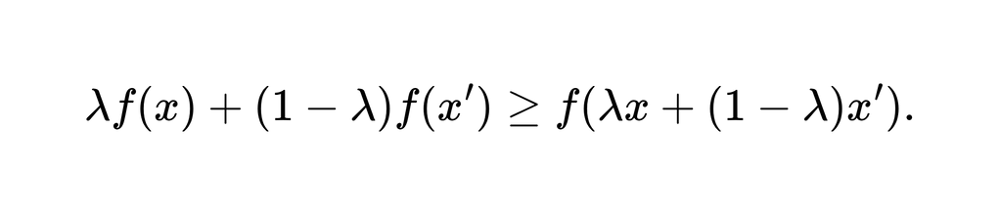
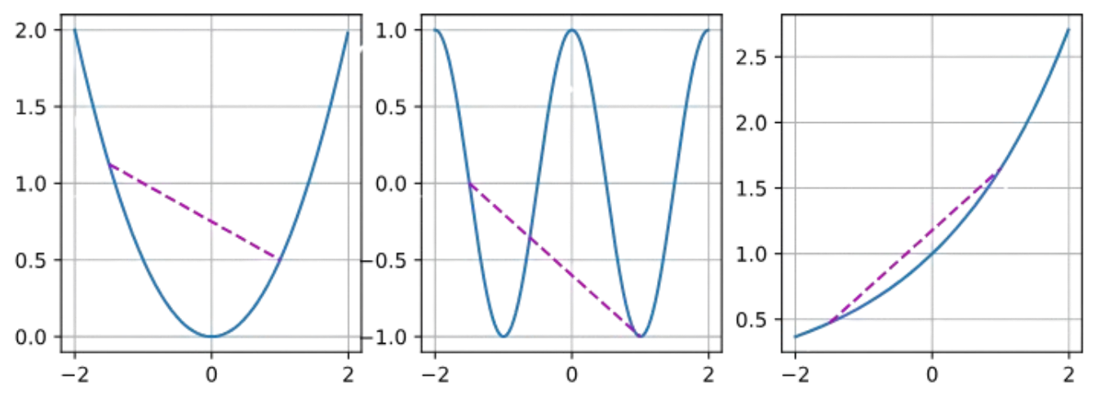
CONVEX FUNCTIONS
Now that we have convex sets we can introduce convex functions f. Given a convex set X, a function f:X→R is convex if for all x,x′∈X and for all λ∈[0,1] we have

Slide 18

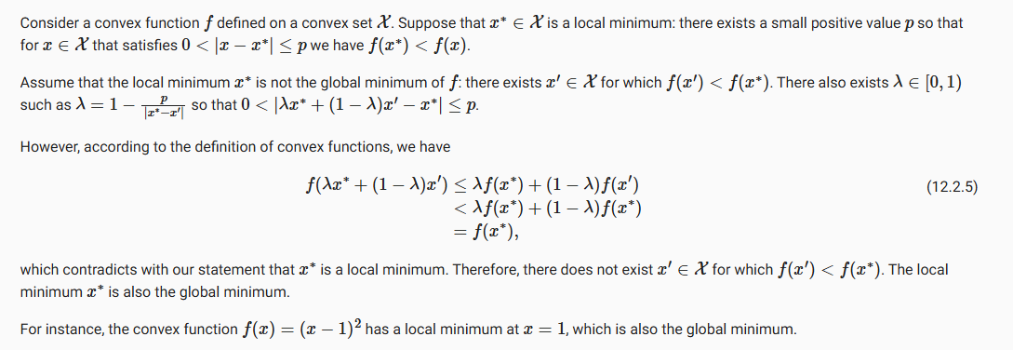
KEY PROPERTY
Local Minima Are Global Minima

Slide 19

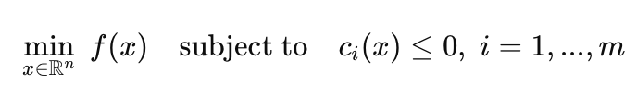
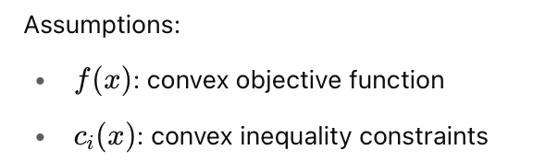
CONSTRAINT

Slide 20
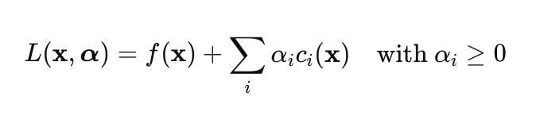
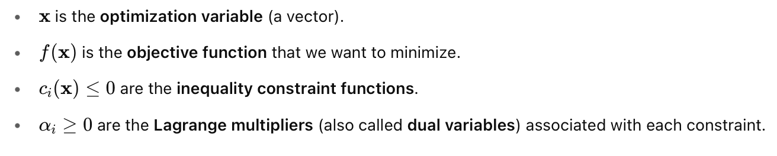
CONSTRAINT
Lagrangian

Slide 21
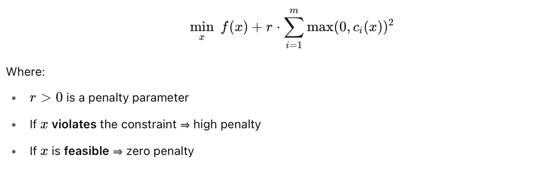
CONSTRAINT
Penalty

Slide 22

Q&A

Slide 23

WELL DONE

